Slide 1
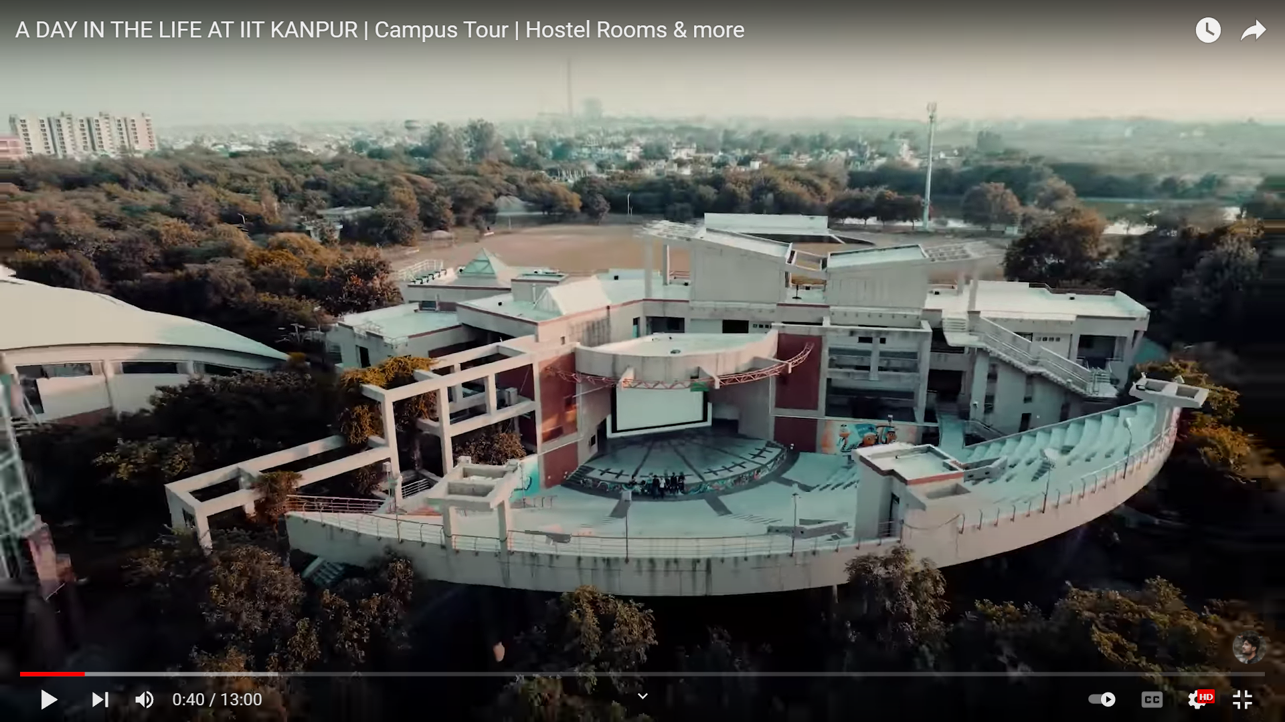
TA201 Design Project
Project Idea:
OAT (Open Air Theatre )
IIT K

Slide 2
OAT at IITK
In IIT Kanpur, we have Student Activity Center (SAC) which is the hub of all the extracurricular activities of students. It has rooms for all the clubs of Student's Gymkhana. It also has Open Air Theatre (OAT) with a seating capacity of over 1400 people.
It is used in almost every inter-hall competition like Galaxy, Takneek etc and for many shows in the institute. We also have a projector and a great sound system. Our Film and Media Club arranges the screening of various movies in a regular time period.
Various Functions are organized here every year. Some are:
Fresher's Night is organized every year for 1st year students.
Various Performances of Udghosh (Annual Sports Festival of IIT Kanpur) are organized.
All the events of Takneek (Inter-Hall Technical Competition) are held here.
All the events of Galaxy (Inter-Hall Cultural Competition) are also held here.
Many shows of Techriti (Annual Technical Festival) were also performed here.
Musical Extravaganza also organized here twice in a year.
Every single match of FIFA World Cup 2014 was screened here.
There is also a food court where we have food available 22.5 hours of the day. It has shops vending snacks, Rolls, Dosas etc. We can have food there till 4:00 am.

Slide 3
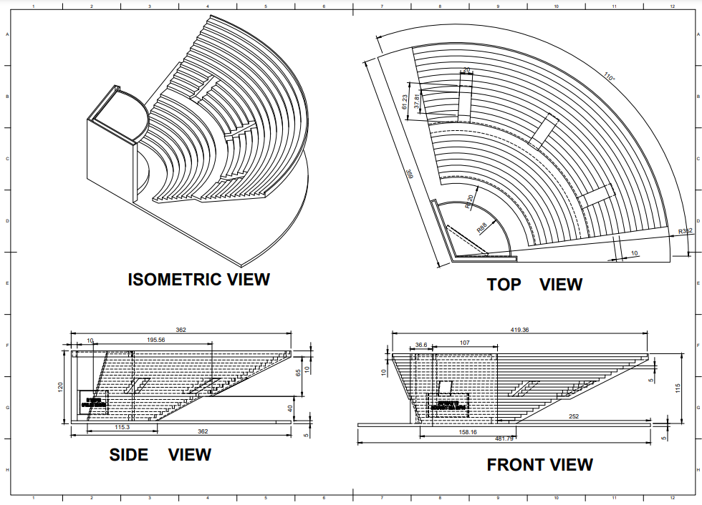
ORTHOGRAPHIC DRAWING

Slide 4
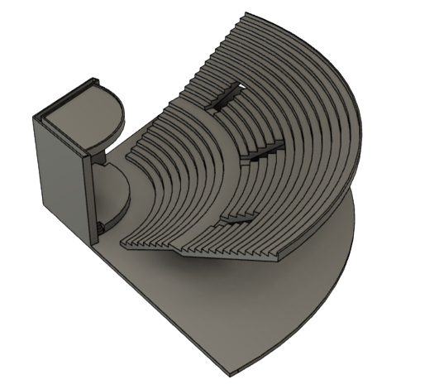
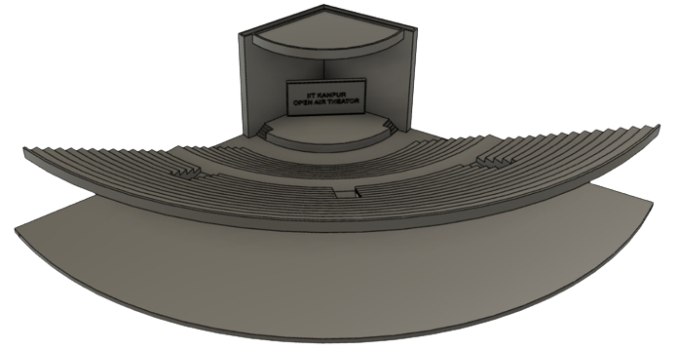
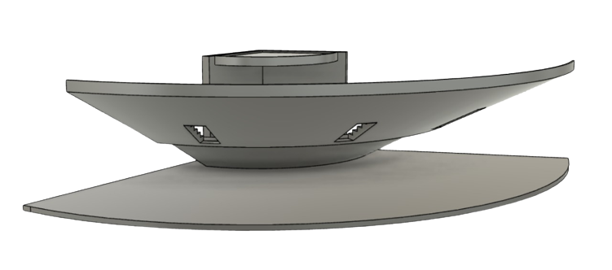
DESIGNED MODEL IN FUSION 360

Slide 5
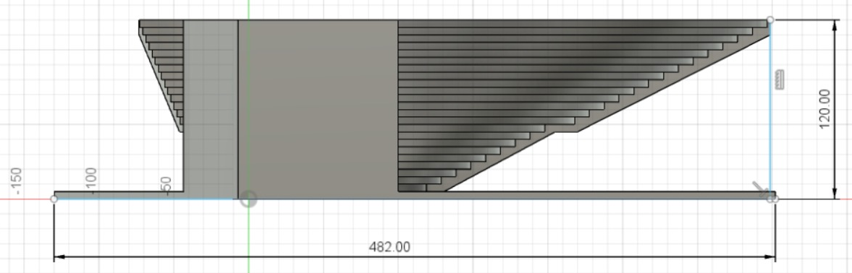
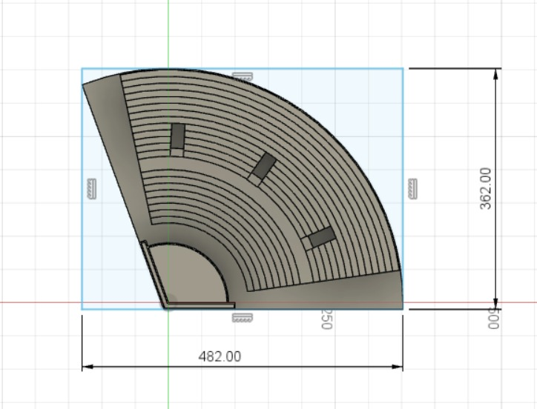
DIMENSIONING

Slide 6
PARTS WITH THEIR
MANUFACTURING PROCESSES

Slide 7
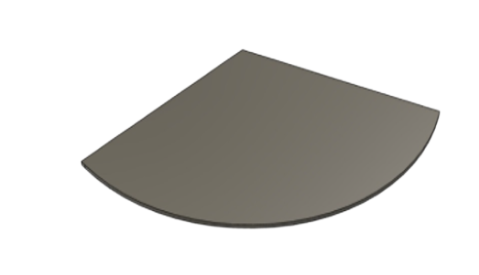
Materials Used:
Processes used:
Mild Steel Discs
Cutting
Cleaning treatments

Slide 8
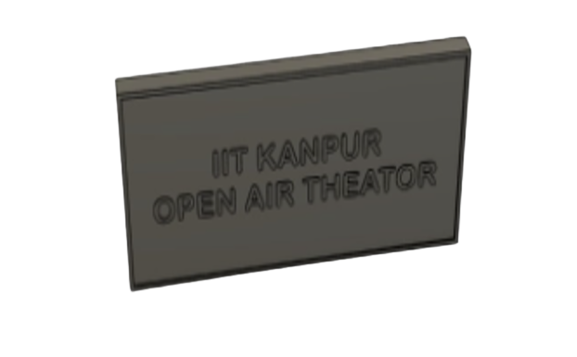
Materials Used:
Processes used:
Thermocol
Cello Tape
Cutting
Adhesive joining

Slide 9
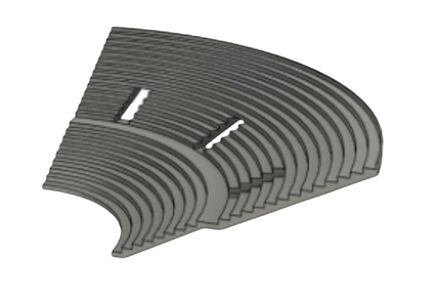
Materials Used:
Processes used:
Mild Steel Flat
Metal forming
Soldering
Cutting
Brazing

Slide 10
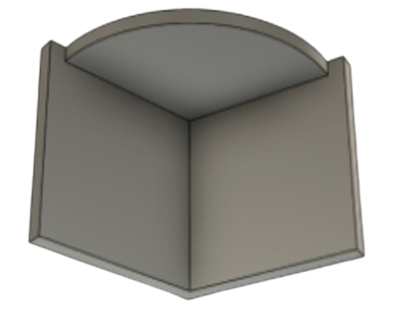
Material used:
Processes Used:
Cutting
Brazing
Cleaning treatments
Mild Steel Flat
Mild Steel Discs

Slide 11
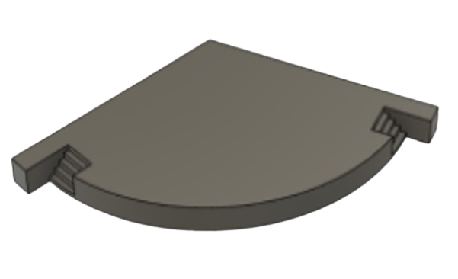
Material used:
Processes Used:
Mild Steel Flat
Mild Steel Discs
Cutting
Brazing
Cleaning treatments
Material removal

Slide 12
S1G2 GROUP
WORK DISTRIBUTION
NAME (Roll NO.) | WORK DONE
Aditya Kaurav (200055) | Process and parts
Aditya Kushwaha (200051) | PPT compilation
Akshat Bajaj (200083) | 3D modelling Fusion 360
Akshat Mishra (200086) | Presentation
Amit Kumar (200109) | 3D modelling Fusion 360
Amit Jain (200108) | Isometric dimensions
Amit Madhesia (200111) | Isometric drawing

